Slide 1
Polymorphism in C++

Slide 2

Polymorphism
The word “polymorphism” means having many forms.
In simple words, we can define polymorphism as the ability of a message to be displayed in more than one form.
Polymorphism is considered one of the important features of Object-Oriented Programming.
Polymorphism is the method in an object-oriented programming language that performs different things as per the object's class, which calls it.
With Polymorphism, a message is sent to multiple class objects, and every object responds appropriately according to the properties of the class.

Slide 3
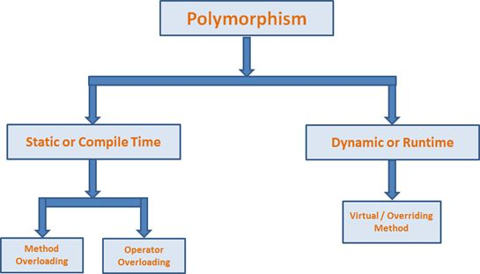
Types of Polymorphism

Slide 4
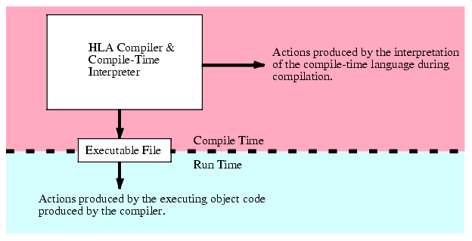

Slide 5

Static vs. Dynamic Binding
Binding : The determination of which method in the class hierarchy is to be invoked for a particular object.
Static (Early) Binding : occurs at compile time, when the compiler can determine which method in the class hierarchy to use for a particular object.
Dynamic (Late) Binding: occurs at run time, when the determination of which method in the class hierarchy to use for a particular object occurs during program execution.

Slide 6
Compile Time Polymorphism
Compile-time polymorphism is also known as static polymorphism or early binding.
Compile-time polymorphism is a polymorphism that is resolved during the compilation process.
Overloading of methods is called through the reference variable of a class.
Compile-time polymorphism is achieved by method overloading and operator overloading.

Slide 7

Method/Function Overloading
Function overloading means one function can perform many tasks. In C++, a single function is used to perform many tasks with the same name and different types of arguments.
In the function overloading function will call at the time of program compilation. It is an example of compile-time polymorphism.

Slide 8
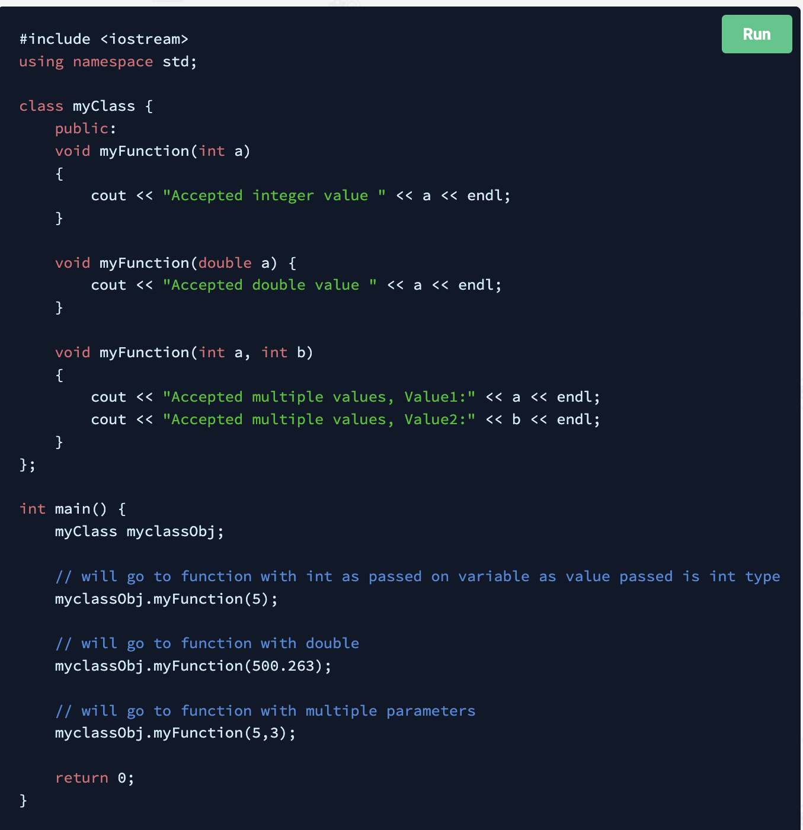
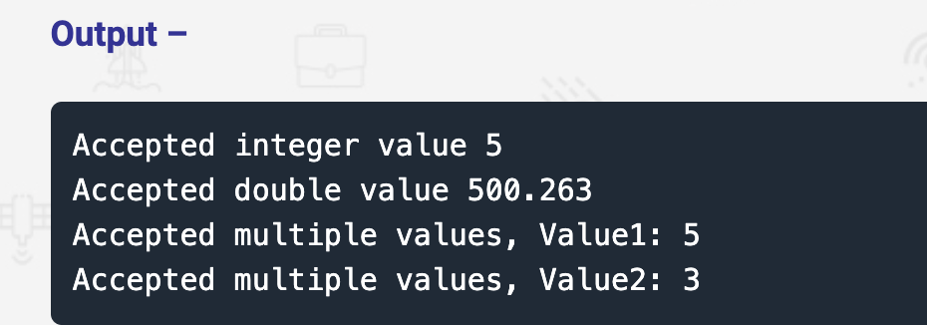
Method Overloading Example

Slide 9

Operator Overloading
C++ has the ability to provide the operators with a special meaning for a data type, this ability is known as operator overloading.
An operator is said to be overloaded if it can be used to perform more than one function. Operator overloading is an overloading method in which an existing operator is given a new meaning.
For example, we can make use of the addition operator (+) for string class to concatenate two strings. We know that the task of this operator is to add two operands. So a single operator ‘+’, when placed between integer operands, adds them and when placed between string operands, concatenates them.

Slide 10
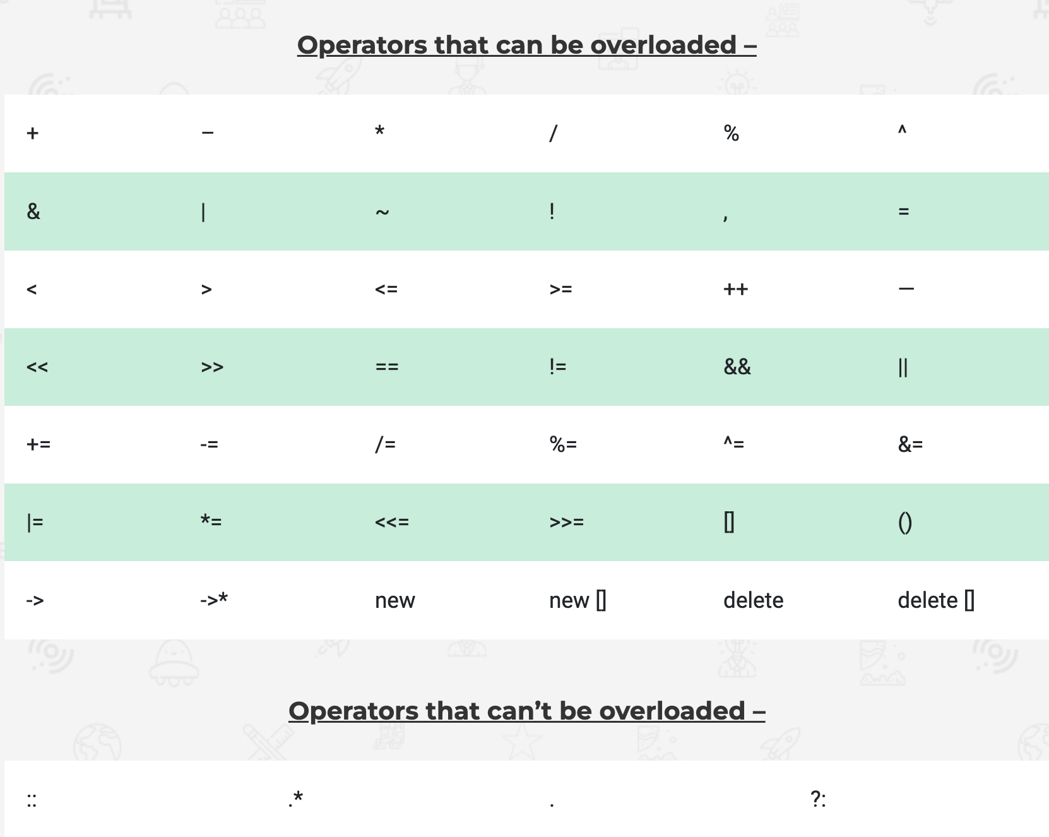

Slide 11
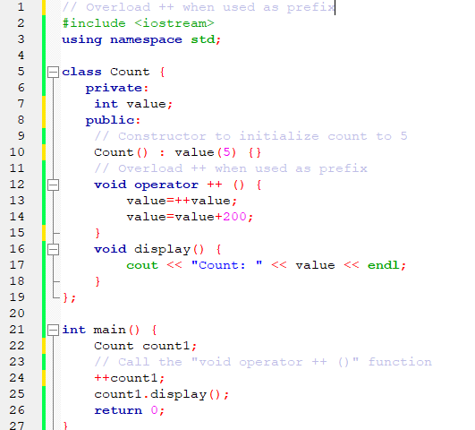
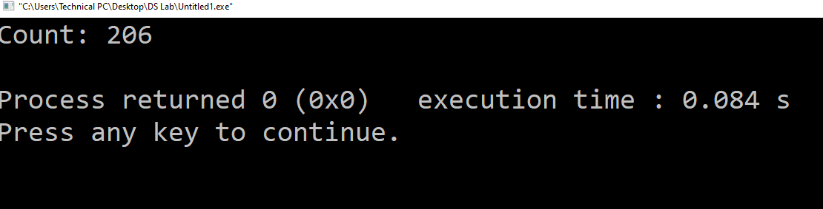
Operator Overloading Example

Slide 12
// Multiplication of two fractions
#include <iostream>
using namespace std;
class Frac {
private:
int a;
int b;
public:
Frac() : a(0), b(0) {}
void in() {
cout << "Enter the numerator : ";
cin >> a;
cout<< "Enter the denominator : ";
cin >> b;
}
// Overload the * operator
Frac operator * (const Frac &obj) {
Frac temp;
temp.a = a * obj.a;
temp.b = b * obj.b;
return temp;
}
void out() {
cout<<"The fraction is "<< a<<"/ "<<b;
}
};
int main() {
Frac F1, F2, result;
cout << "Enter the first fraction:n";
F1.in();
cout << "Enter the second fraction:n";
F2.in();
// complex1 calls the operator function
// complex2 is passed as an argument to the function
result = F1 * F2;
result.out();
return 0;
}

Slide 13
Thank You!!!!

